Slide 1


Exploratory Data Analysis on Credit Card Fraud Detection
Name: Shahana T
Reg No: 12219504
Section: K22UR
Roll No: RK22URA26

Slide 2
Table of Contents
1. Abstract
2. Problem Statement
3. Introduction
4. Methodology
5. Result
6. My Analysis
7. Conclusion
8. Reference

Slide 3

Abstract
Analyze credit card transaction data to identify fraudulent activities by employing
Exploratory Data Analysis (EDA) to uncover pattems, anomalies, and trends. Utilize
Principal Component Analysis (PCA) and feature selection techniques to reduce
dimensionality and analyze correlations among features. Focus on identifying
important relationships between anonymized features and transaction amounts to
understand their impact on fraud. Highlight key predictors of fraudulent behavior to
provide valuable insights for improving fraud detection strategies.
Problem Statement
Credit card fraud detection is challenging due to the significant class imbalance, as fraud cases make up only a small fraction of all transactions. The goal is to explore transaction behaviors and identify key indicators of fraud using statistical and visualization techniques. These insights can help
strengthen fraud detection mechanisms and enhance overall financial security.

Slide 4
Introduction
The primary objective is to leverage credit card transaction data to accurately distinguish between fraudulent and legitimate transactions.
The significant challenge lies in the dataset's imbalance, with fraudulent transactions representing a mere 0.172% of the total, demanding specialized techniques for accurate detection.
Dataset description
The dataset contains anonymized credit card transactions by European cardholders over two days in September 2013.
The dataset includes the following columns:
Time: The time passed since the first transaction
V1 to V28: These are anonymized feature columns representing transformed variables
Amount: The transaction amount.
Class: The target variable, where '1' indicates a fraudulent transaction and '0' indicates a non-fraudulent transaction.

Slide 5
Methodology
1
Data Cleaning
Irrelevant features were removed, 5% missing values introduced, and outliers addressed using Z-Score for data
robustness.
2
Data Transformation
Features were scaled and normalized, including log transformation for skewed variables like transaction amount,
ensuring data comparability.
3
Exploratory Data Analysis
Descriptive statistics, correlation heatmaps, and fraud rate analysis were employed to pinpoint key fraud indicators
and patterns.
4
Dimensionality Reduction
PCA reduced data dimensions, simplifying visualization and analysis of fraud versus non-fraud instances.
5
Multivariate Analysis
Clustering techniques were applied to principal components, revealing distinct patterns and separability of fraudulent transactions, particularly in features V10 and V12.

Slide 6
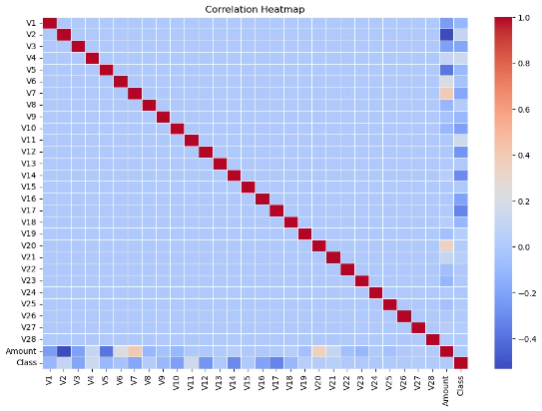
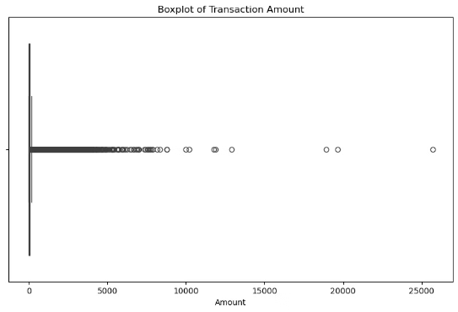
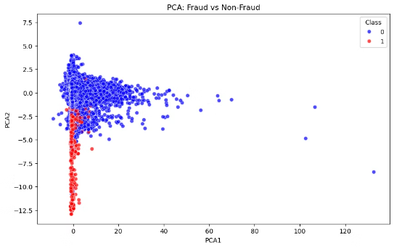
Results - Key Findings
Correlation Heatmap
Visualizes fraud (red) and non-fraud (blue) transactions based on the first two principal components, showing clear clustering differences.
Highlights the presence of extreme outliers in transaction amounts, indicating skewed data distribution.
Figure 2
Displays the relationships between features, showing minimal correlation of "Amount" and "Class" with the principal components.
Figure 1
Figure 3
Boxplot of Transaction Amount
PCA: Fraud vs Non-Fraud

Slide 7
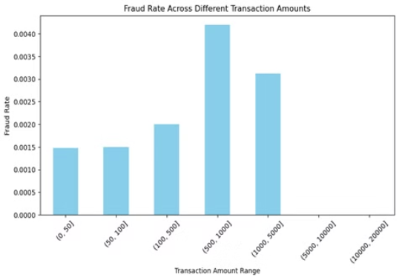
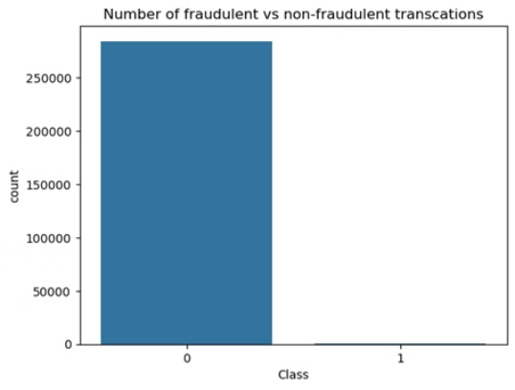
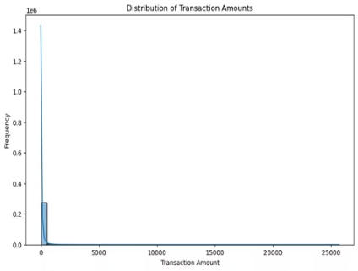
Fraud Rate Across Transaction Amounts
Fraudulent vs. Non-Fraudulent Transaction
Highlights the highly skewed distribution of transaction amounts, with most transactions being low-value.
Figure 3
Figure 1
Depicts the significant imbalance, with fraudulent transactions being extremely rare compared to non-fraudulent ones.
Shows that mid-range transactions ($500-$1000) have the highest fraud rate.
Figure 2
Distribution of Transaction Amounts

Slide 8
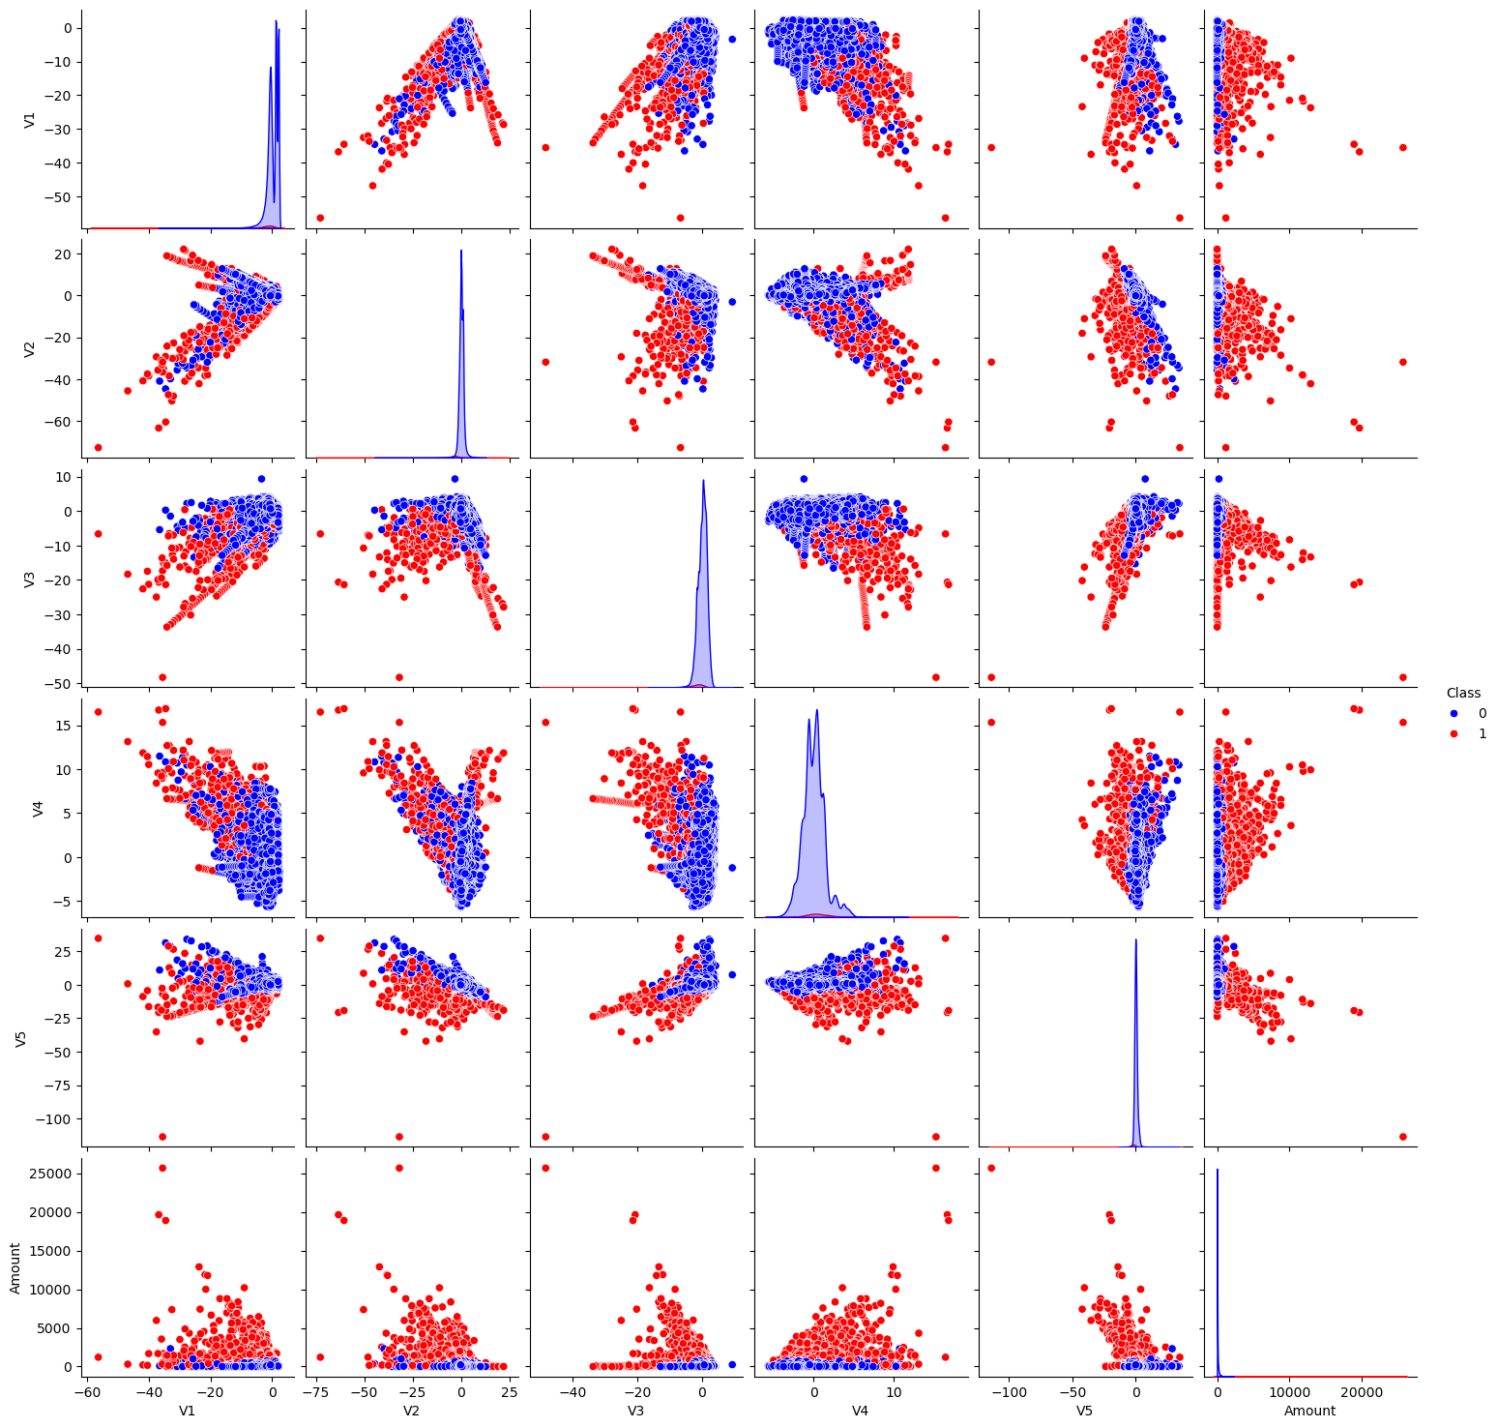
Pair Plot for Multivariate Insights
Relationships between multiple variables in a dataset.
Highlights how different classes (red and blue) are positioned relative to each other in those dimensions.
Scatter Plots:
Display relationships between feature pairs.
- V1 and V2 show dispersed patterns, while V3 vs. V4 and V4 vs. V5 hint at possible class separation.
Class Differentiation:
Blue (Class 0) and Red (Class 1) dots help visualize fraud vs. non-fraud.
- Some clustering of red dots in V3, V4, and V5 suggests these features may help detect fraud.
Insights:
Patterns suggest that certain feature combinations may improve fraud detection

Slide 9
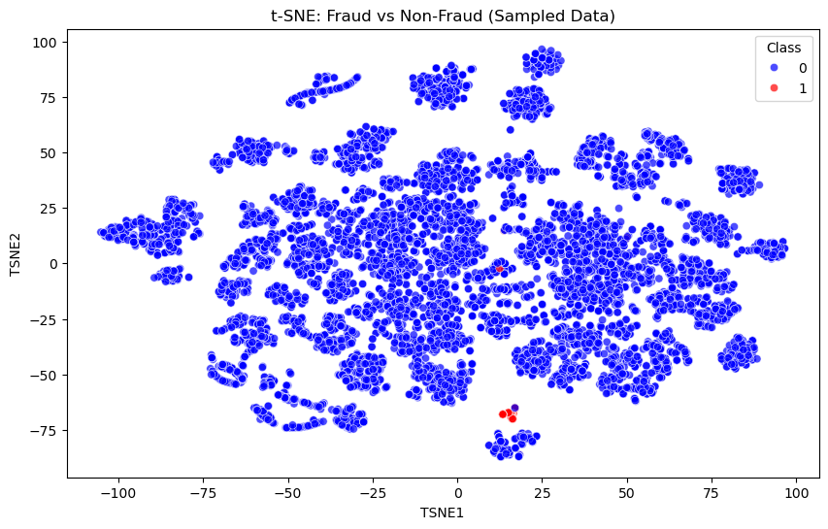
t-SNE for High Dimensional Visualization
t-SNE (t-Distributed Stochastic Neighbor Embedding):
Commonly used for visualizing clusters in complex datasets, especially with labeled data (here, fraud vs. non-fraud).
Clusters and Separation:
Non-fraud cases (blue) are densely clustered, indicating similarity among these samples.
Fraud cases (red) are scattered and sparse, indicating they have distinct features from the
Majority class (non-fraud).
Purpose of Visualization
Highlights the imbalance in fraud detection data (few red dots vs. many blue dots).
Shows that fraud cases are harder to isolate due to overlap with non-fraud clusters, suggesting a challenge in detecting fraudulent activity in the dataset.

Slide 10
My Analysis
Descriptive Statistics:
Cluster Analysis:
Fraud Rate by Transaction Amount:
Most transactions are non-fraudulent, making it hard for models to detect fraud effectively.
Use class balancing or specialized algorithms(SMOTE) to improve fraud detection.
Handling imbalance prevents bias toward non-fraudulent cases and improves model accuracy.
Fraudulent transactions form clear clusters, especially in features like V10 and V12.
Clustering helps highlight fraud patterns that are otherwise hard to detect.
Shows clustering can be a valuable tool for identifying characteristics of fraud.
Larger transaction amounts are more likely to be flagged as fraudulent, indicating a risk factor.
Incorporating transaction amount can improve fraud detection models.
Focusing on higher-value transactions may enhance accuracy.

Slide 11
Analysis - Exploratory Insights
1
Data Imbalance Challenge
2
Feature Correlations
3
Transaction Amount's Effect
The extreme class imbalance, with only 0.172% fraudulent transactions, presents a significant challenge.
This underscores the need for techniques like resampling or anomaly detection to address the imbalance and improve model accuracy.
Heatmaps and correlation analysis highlighted V10 and V12 as strong fraud indicators.
This finding enables effective feature prioritization, focusing on these key features during model training for potentially higher detection accuracy.
Analysis demonstrated a higher fraud risk associated with larger transactions.
Binning transaction amounts helped identify thresholds beyond which fraud likelihood increases, informing potential alert triggers and risk management strategies.

Slide 12
Conclusion
The analysis identified key features and transaction attributes indicative of fraud, such as high transaction amounts and specific anonymized variables like V10 and V12. Dimensionality reduction using PCA helped reveal patterns and improve visualization, making it easier to detect fraudulent activities.
A significant challenge addressed in this project was the extreme class imbalance, with fraudulent cases comprising only 0.172% of the dataset. Anomaly detection techniques and PCA proved effective in overcoming this limitation and improving fraud pattern recognition.
Clustering and correlation analysis highlighted significant predictors, providing critical insights for developing targeted fraud detection strategies. Feature selection based on these insights demonstrated the potential to enhance model efficiency by focusing on high-impact attributes.
Future work could explore advanced machine learning models, such as XGBoost and Random Forest, to further improve fraud detection accuracy and robustness.

Slide 13
References
Dataset Used:
The dataset for credit card fraud detection used in this project is available on data.gov.in
Exploratory Data Analysis (EDA):
This detailed guide explains EDA techniques, including how to visualize data distributions, identify correlations, and detect outliers. It focuses on Python libraries like Matplotlib and Seaborn for analyzing datasets in the context of predictive modeling. https://www.ibm.com/topics/exploratory-data-analysis

Slide 14
THANK YOU

